Slide 1
Data Communications for a Global Environment
Review
Increasing Computer capacity and decreasing cost
Geographic expansion of public network access to Local ISP’s
Business processes becoming more complex and multi-national
General consumer demand (gamers, e-mail, socialization networks)
Fueling the growth of low cost public networking

Slide 2
Data Communications for a Global Environment
Exercise Scenario:
The Application program on system 1 has as its output, a number, which is represented as an 8 bit binary number. You want to store that output on a SQL database residing on system 2. Assume the two computers
have a compatible physical connection, There are no other computers on the network transferring data, no other application programs are running on your computer at this time. You have been asked to write a communication program to transfer the output of a Browser Application on system 1 to the database on System 2.
Assignment: Identify all the processes (functions) that have to be considered
Hint: think about similar patterns that may exist in other processes like the postal system.
2
1 - 2
1 - 2
Notes:
I f you were writing a communication program what are some of the functions would you need to consider?

Slide 3
Data Communications for a Global Environment
I f you were writing a communication program what are some of the functions would you need to consider?
some of the factors
What software program is sending the data
What is the physical address you want to send the message to.
Is the receiving computer available to receive a message
How many messages can he manage
How do I tell the start of a message
How do I tell the end of a message
What software program am I sending the message to
How do I know the message was delivered
What do I do if it is not delivered
Is there an error in the message
What do I do if there is an error in the message
transfer the data to the database
3
1 - 3
1 - 3
Notes:
I f you were writing a communication program what are some of the functions would you need to consider?

Slide 4
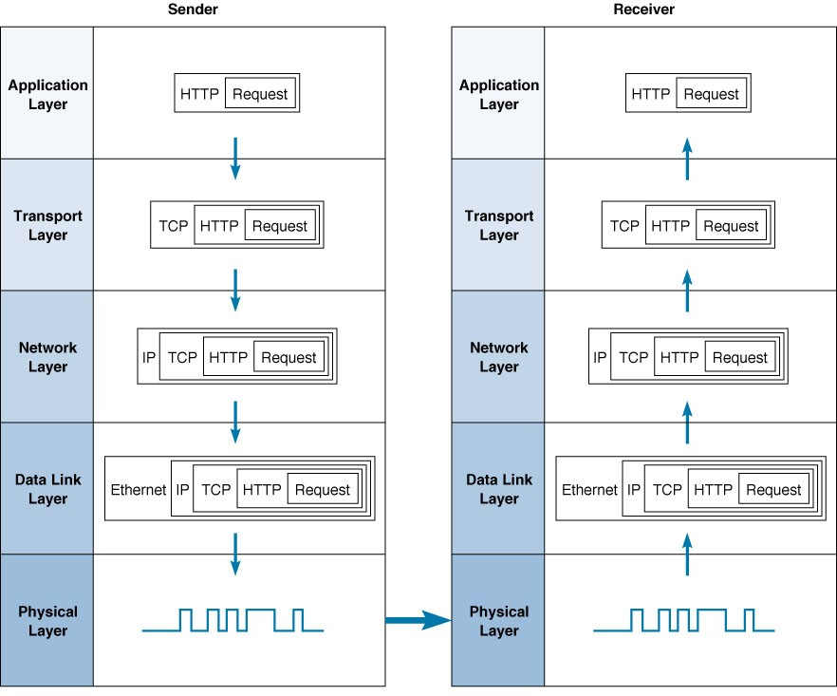
Messaging Thru Layers
Data Communications for a Global Environment
4
1 - 4
1 - 4

Slide 5
Data Communications for a Global Environment
Lecture 3:
The Application Layer and Distributed Application
Architectures.

Slide 6
Chapter 2
Data Communications for a Global Environment
Application Layer

Slide 7
Application Layer - Introduction
Data Communications for a Global Environment
Applications (e.g., email,
Custom Web, word processing)
Application Layer
Transport Layer
Network Layer
Functions of Application Layer
  Presentation logic
    Presentation of info to user and acceptance of user commands
  Application logic
    Business logic such as word processors, spreadsheets
  Data access logic
    Processing required to access stored data (e.g., SQL)
  Data storage
    Storing of data generated by programs (e.g., files, records)
Notes:
Codd’s 12 rules of RDBMS. Rule 5 – a comprehensive data sublanguage rule.

Slide 8
Application Architecture
Data Communications for a Global Environment
The Architecture of a software-intensive system is the:
structure or structures of the system, which is comprised of software elements,
the externally visible properties of those elements,
and relationships among them.
Rozanski & Woods

Slide 9
Systems Structures
Data Communications for a Global Environment
Static Structures (design time organization)
Software Elements: could be Modules, Classes, Stored procedures or any self contained code unit.
Data Elements: classes, RDB entities/tables, data files
Internal Hardware Elements:
- Computers and their constituent parts (CPU, disk)
- Networking Elements (cables, routers, hubs)

Slide 10
Software Patterns
Data Communications for a Global Environment
The purpose of a software pattern is to share a proven, widely acceptable solution to a particular design problem in a standard form that allows it to be easily reused.
- Architectural Styles: record solutions for system level organization
- Design Patterns: record solutions to detailed design problems
- Language Idioms: capture useful solution to language specific problems.

Slide 11
Common Architectural Styles
Data Communications for a Global Environment
Client /Server
Tiered Computing (.net)
Peer to Peer
Layered Implementation
Publisher Subscriber
Model-View-Controller (Java)
Pipes and Filters
Asynchronous Data Replication
Distribution Tree
Integration Hub
Tuple Space
Examples of Styles
we will see in this
course.

Slide 12
Client Server Style
Data Communications for a Global Environment
Widely used style comprised of two types of elements
- Server that provides one or more services via
a well defined interface
- Client that uses those services as part of its operation

Slide 13
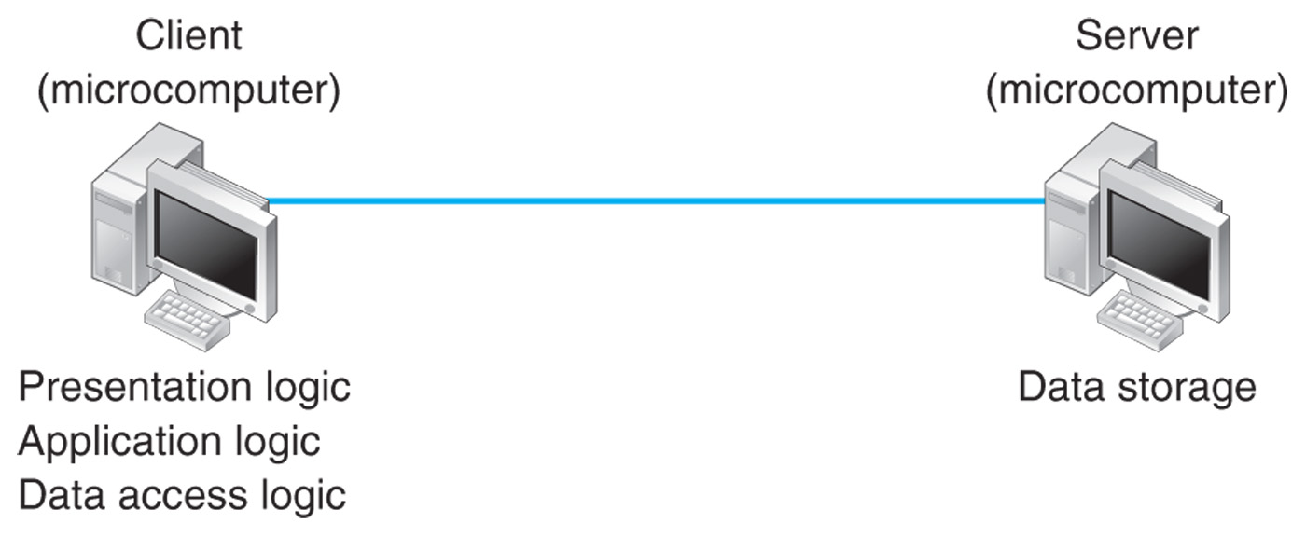
Examples of Client Server Styles
Data Communications for a Global Environment
Client Based Computing (Fat Client)(2-Tier)

Slide 14
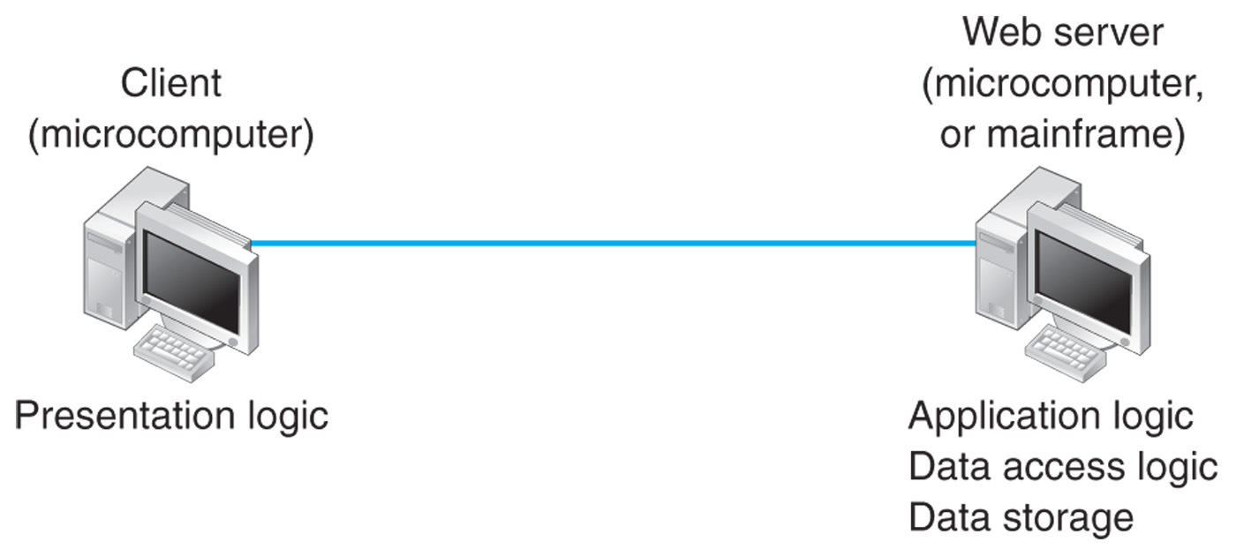
Examples of Client Server Styles
Data Communications for a Global Environment
Client Based Computing (Thin Client)(2-Tier)

Slide 15
Tiered Computing Styles
Data Communications for a Global Environment
A tiered system is considered to contain a number of tiers of computation which combine to offer service to an ultimate consumer.
Each tier acts as a server for its caller and as a client for the next tier in the architecture. A key principle is that a tier can communicate in this way only with the tiers immediately on either side of it and is not aware of the existence of other tiers.

Slide 16
Common Tiers in Enterprise Information Systems
Data Communications for a Global Environment
Presentation Layer (user interface)
Business Process (combining a sequence of business transactions into a service)
Business Transactions (The fundamental business operations in the system that act on the business entities)
Data Access (Providing governed access to business entities)
Data Storage (The databases in which the enterprises data resides)

Slide 17
Common Tiers in Enterprise Information Systems
Data Communications for a Global Environment
Advantages: This style allows clear separation of concerns between tiers and provides the potential for reusability of the simpler tiers (data storage, data access and business transactions) across a number of systems
Disadvantages: include the overhead of communication between the tiers and additional development complexity arising from the number of system elements that need to be developed and integrated across tiers

Slide 18
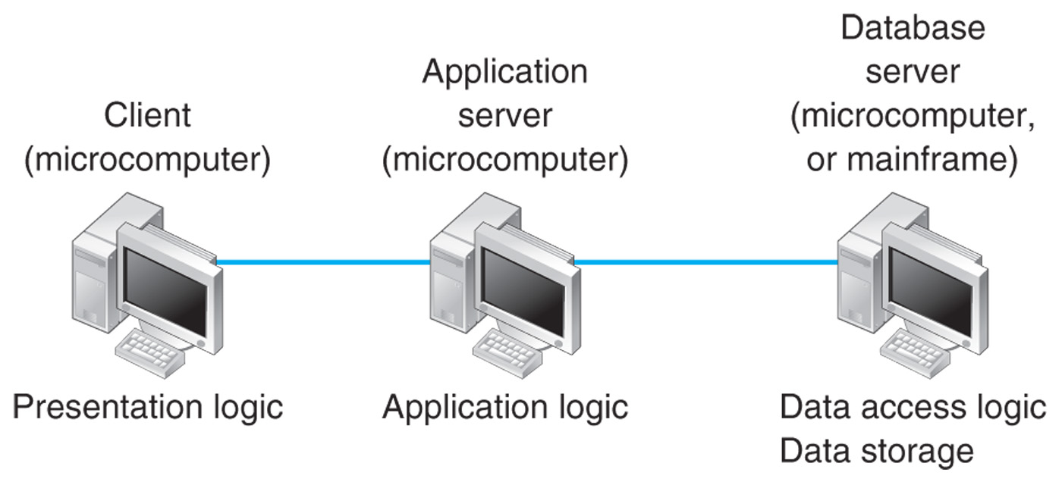
Examples of Client Server Styles
Data Communications for a Global Environment
Client Based Computing (3-Tier)

Slide 19
Multi-Processor Architecture
Data Communications for a Global Environment
Involve more than two computers in distributing application program logic
  2-processor architecture
    Uses clients and servers in a balance, very popular approach in simple LANs
  3-processor architecture
    3 sets of computers involved
  N-tier architecture
    More than three sets of computers used, more typical across complex organizations
    Allows load balancing across servers

Slide 20
Multi-Processor Architectures
Data Communications for a Global Environment
Advantages
  Better load balancing:
    More evenly distributed processing. (e.g., application logic distributed between several servers.)
  More scalable:
    Only servers experiencing high demand need be upgraded
Disadvantages
  Heavily loaded network:
    More distributed processing necessitates more data exchanges
  Difficult to program and test due to increased complexity

Slide 21
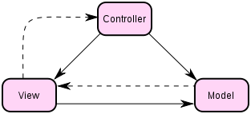
Other Architectural Styles
Data Communications for a Global Environment
Model – View – Controller:

Slide 22
Model – View – Controller Architecture:
Data Communications for a Global Environment
The Model is used to manage information and notify observers when that information changes. The model is the domain-specific representation of the data upon which the application operates.
The View renders the model into a form suitable for interaction, typically a user interface element. Multiple views can exist for a single model for different purposes. A viewport typically has a one to one correspondence with a display surface and knows how to render to it.
The Controller receives input and initiates a response by making calls on model objects. A controller accepts input from the user and instructs the model and viewport to perform actions based on that input.
An MVC application may be a collection of model/view/controller triads, each responsible for a different UI element.

Slide 23
Other Architectural Styles
Data Communications for a Global Environment
Layered Implementation: The style organizes a system’s implementation into a stack of layers with each layer providing a service to the layer above it and requesting services from the one below it. The layers are ordered by the degree of abstraction they represent.
The top of the stack is the most abstract (organization-specific operations) and the bottom of the stack is the least abstract (operating system-specific libraries).
Communication stacks are classic examples of layered organization.

Slide 24
Criteria for Choosing Architecture
Data Communications for a Global Environment
Infrastructure Cost
  Cost of servers, clients, and circuits
  Mainframes: very expensive; terminals, PCs: inexpensive
Development Cost
  Mainly cost of software development
  Software: expensive to develop; off-the-shelf software: inexpensive
Scalability
  Ability to increase (or decrease) in computing capacity as network demand changes
  Mainframes: not scalable?; PCs: highly scalable?

